Slide 1
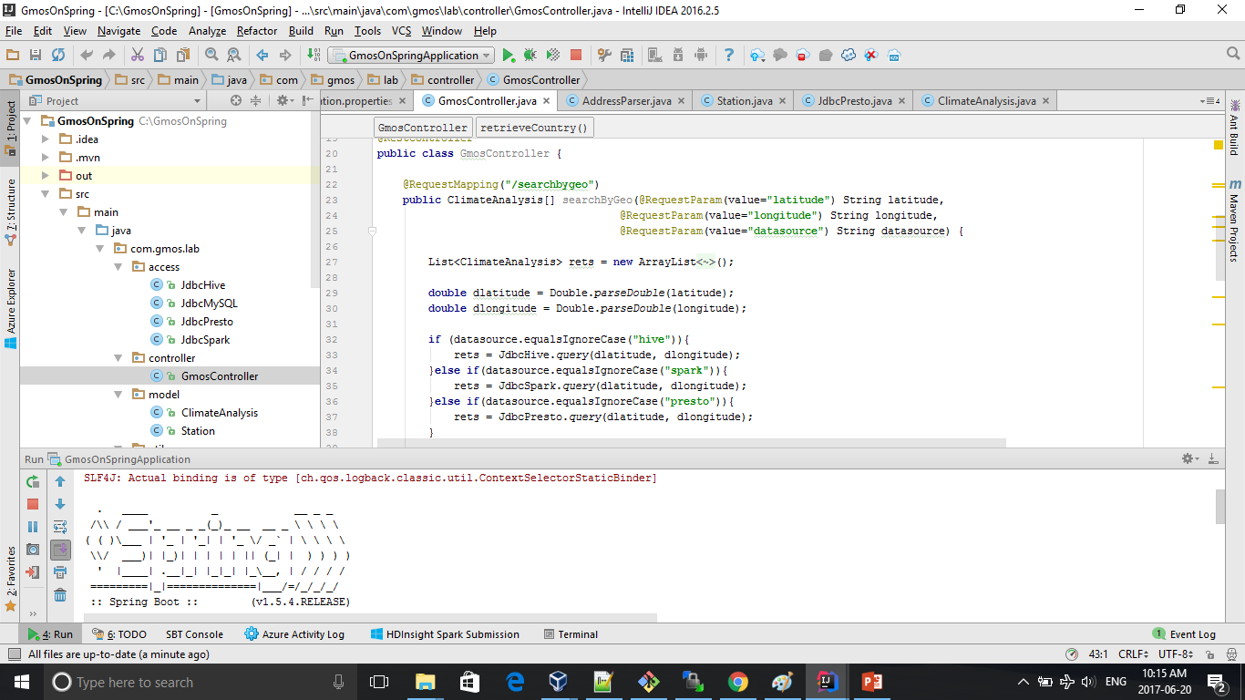
Bonus 3 Solution – Start Spring Boot

Slide 2
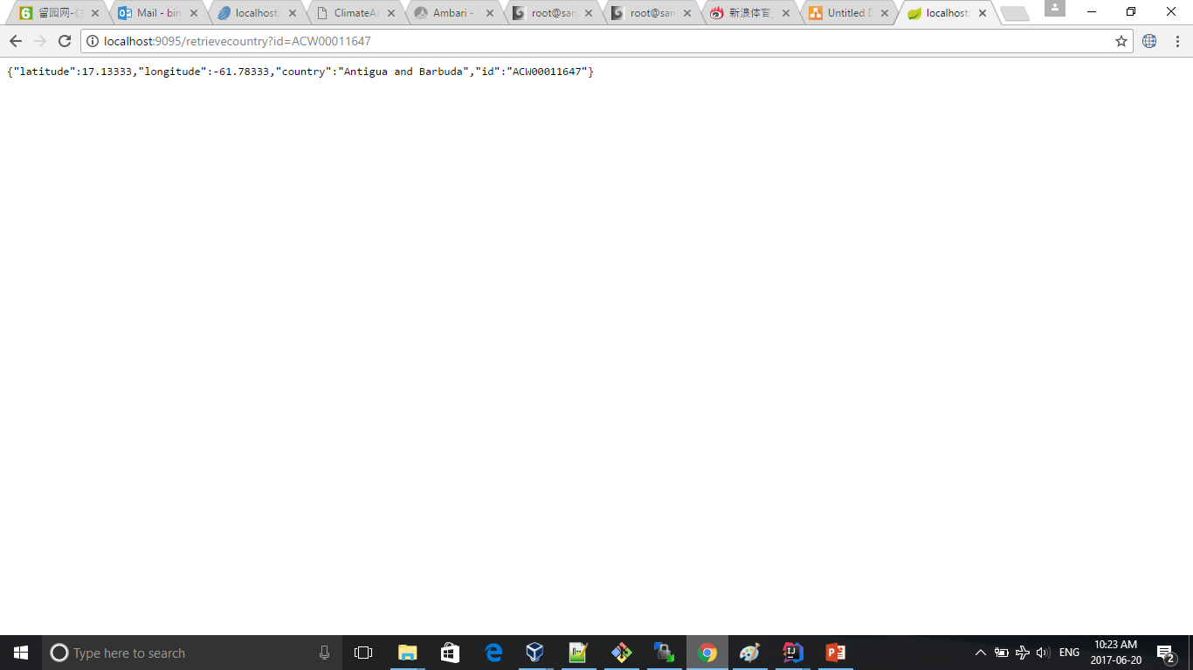
Bonus 3 Solution

